Slide 1
Article #10 Amend Zoning Bylaw: #10: Accessory Dwelling Unit
Presented by: Marnie Hoolahan, Vice Chair Planning Board

Slide 2
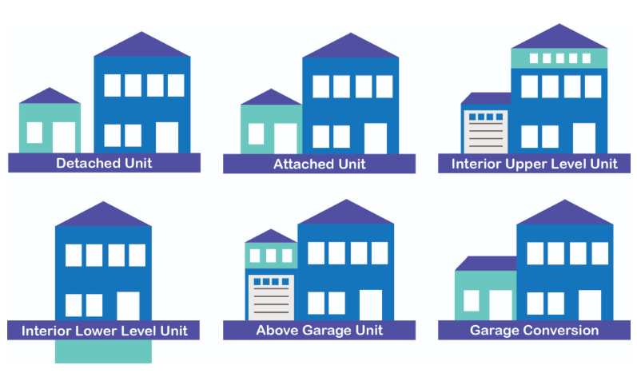
What is an Accessory Dwelling Unit (ADU)?
A self-contained housing unit (e.g. kitchen, sleep and sanitary facilities)
On the same lot as a Principal Dwelling
An ADU maintains a separate entrance, either directly from the outside or through an entry hall or corridor shared with the Principal Dwelling
An ADU comes in many shapes and styles

Slide 3
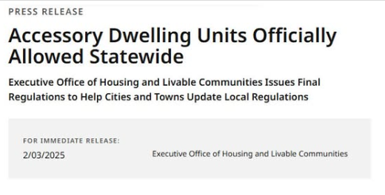
Why is Southborough Amending its ADU Bylaw?
Southborough is administratively amending its bylaw to comply with state law, approved on August 6, 2024
On Aug. 6, 2024, Governor Healey signed the Affordable Homes Act into law (Chapter 150 of the Acts of 2024). Section 8 of the Affordable Homes Act amends the Zoning Act to allow Accessory Dwelling Units (ADUs) up to 900 square feet to be built by right in single-family zoning districts.

Slide 4
Our Existing Bylaw Requires “Clean-up”
Replace the term “Apartment” with “Dwelling Unit”
Remove current definition and replace with State definition of ADU while retaining that “no mobile home or travel trailer” is included as an ADU
Remove from IP district
Add State ADU “by right” requirements into all districts except IP
Retain our code for >900sq ft ADUs, but refine language to reflect “gross floor area is greater than ½ gross floor area of principal dwelling or greater than 900 sq. ft.”
Retain incentives under Adaptive use of Historic Buildings
Removed cap on the percentage of number of ADUs that the town can have – currently 5%

Slide 5
What Will Change in Our Town Zoning?
Passing this zoning bylaw will update the language to be in harmony with the state
Retain our citizens’ rights to build an ADU with a special permit that exceed the state limits of “gross floor area is greater than ½ gross floor area of principal dwelling or greater than 900 sq. ft.”
Provide clarity in the bylaw language

Slide 6
Current vs. Proposed Definition
 | Current (Outdated) | Proposed (State Law Compliant)
Definition | Accessory Apartment: A subsidiary dwelling unit created within or as an extension to a single-family dwelling or a structure accessory thereto, with separate cooking, sleeping and bathroom facilities. | Accessory Dwelling Unit: A self-contained housing unit, inclusive of sleeping, cooking, and sanitary facilities on the same lot as a Principal Dwelling. An Accessory dwelling unit shall maintain a separate entrance, either directly from the outside or through an entry hall or corridor shared with the Principal Dwelling sufficient to meet the requirements of the state Building Code for safe egress. Accessory dwelling units shall not be located in a travel trailer or mobile home.

Slide 7
Current vs. Proposed District Updates
District | Current (Outdated) | Proposed (State Law Compliant)
174-8.12 (Downtown District) D Uses Permitted by Special Permit | (1) Accessory apartment | (1) Accessory dwelling unit whose gross floor area is greater than 900 sq. ft
174-8.2 (Residence A District) A Permitted Use | No # 11 | (11) Accessory dwelling unit that is not larger in gross floor area than ½ the Gross Floor Area of the Principal Dwelling or 900 Sq. ft., whichever is smaller.
174-8.2 (Residence A District) B Uses Permitted by Special Permit | (1) Accessory apartment | (1) Accessory dwelling unit whose gross floor area is greater than 900 sq. ft
174-8.4 BV (Business Village District) D Uses Permitted by Special Permit | (1) Accessory apartment | (1) Accessory dwelling unit whose gross floor area is greater than 900 sq. ft
174-8.5 BH (Highway Business District) C Uses Permitted by Special Permit | (2) Accessory apartment | (2) Accessory dwelling unit whose gross floor area is greater than 900 sq. ft

Slide 8
Current vs. Proposed Special Permit Updates
District | Current (Outdated) | Proposed (State Law Compliant)
174-8.6 IP (Industrial Park District) C Uses Permitted by Special Permit | (2) Accessory apartment | Remove (2) and align numbers according (Administrative note: (Remove (2) accessory apartment and shift the numbers currently labeled (3)- (15) to number (2) through (14))
174-8.7 ID (Industrial District) C Uses Permitted by Special Permit | (2) Accessory apartment | (2) Accessory dwelling unit whose gross floor area is greater than 900 sq. ft
174-8.8 SP (SP Research, Scientific and Professional District) B Uses Permitted by Special Permit | (1) Accessory apartment | (1) Accessory dwelling unit whose gross floor area is greater than 900 sq. ft.

Slide 9
Current vs. Proposed 174-9 Special permit requirements (B)
Current (Outdated) | Proposed (State Law Compliant)
B Accessory apartments. Special permits for accessory apartments may be issued upon referral of the application and receipt and consideration of a report, or after 35 days elapse without such report, from the Board of Health, certifying that adequate provisions have been made in accordance with the requirements of the Board of Health for drainage and for the disposal of sewage and waste generated by the occupancy of the apartment, and from the Planning Board, describing the lot on which the dwelling is located, the neighborhood where it is located and the effect of the proposed apartment thereon, the adequacy of ingress and egress provisions, the recommendations of the Planning Board as to the advisability of granting the special permit and any restrictions that should be imposed as a condition thereof and the provisions for off-street parking in a manner consistent with the character of the premises. If the decision of the Board of Appeals differs from the recommendations of the Planning Board, the reasons therefor shall be stated in the decision. The accessory apartment shall comply with the following conditions and requirements: (1) The habitable floor area of the accessory unit shall not exceed 25% of the habitable floor area of the entire dwelling plus that of any accessory building used for the accessory dwelling. (2) There is no other apartment on the lot on which the accessory apartment is proposed. (3) Not more than the required minimum exterior alterations have been or will be made to the one-family house and to any accessory buildings, and the site plan of the lot and floor plans of the dwelling thereon have been filed with the Building Inspector prior to the application to the Board of Appeals. (4) The total cumulative number of accessory apartments permitted by the Board of Appeals since January 1979 shall at no time exceed 5% of the total number of one-family houses in Southborough at the beginning of the year in which the application is filed, based on the Assessor's records. Residences containing apartments shall be counted as one-family houses for the purposes of this subsection. | B. Accessory dwelling units. Special permits for accessory dwelling units exceeding state law dimensional standards (MGL c. 40A, §1A) may be issued upon referral of the application and receipt and consideration of a report, or after 35 days elapse without such report, from the Board of Health, certifying that adequate provisions have been made in accordance with the requirements of the Board of Health for drainage and for the disposal of sewage and waste generated by the occupancy of the apartment, and from the Planning Board, describing the lot on which the dwelling is located, the neighborhood where it is located and the effect of the proposed apartment thereon, the adequacy of ingress and egress provisions, the recommendations of the Planning Board as to the advisability of granting the special permit and any restrictions that should be imposed as a condition thereof and the provisions for off-street parking in a manner consistent with the character of the premises. If the decision of the Board of Appeals differs from the recommendations of the Planning Board, the reasons therefor shall be stated in the decision. The accessory dwelling unit shall comply with the following conditions and requirements: (1) The habitable floor area of the accessory unit shall not exceed 25% of the habitable floor area of the entire dwelling plus that of any accessory building used for the accessory dwelling (2) There is no other accessory dwelling unit on the lot on which the accessory dwelling unit is proposed. (3) Not more than the required minimum exterior alterations have been or will be made to the one-family house and to any accessory buildings, and the site plan of the lot and floor plans of the dwelling thereon have been filed with the Building Inspector prior to the application to the Board of Appeals.

Slide 10
Current vs. Proposed 174-13.8 Adaptive reuse of historic buildings (B)
Current (Outdated) | Proposed (State Law Compliant)
SubSection (a) Accessory apartments. One accessory apartment or separate rental unit. The accessory apartment shall comply with the following conditions and requirements: [1] The habitable floor area of the accessory unit shall not exceed 35% of the habitable floor area of the entire dwelling, plus that of any accessory building used for the accessory dwelling. [2] There is no other apartment on the lot on which the accessory apartment is proposed. [3] Not more than the required minimum exterior alterations will be made to the single-family house and to any accessory buildings as determined by the SPGA upon written recommendation of the Historical Commission. [4] The number of accessory apartments approved under this section shall not be subject to § 174-9B(4), which limits the number of accessory apartments that can be permitted. | Sub Section (a) Accessory dwelling units. The accessory dwelling unit shall be subject to site plan review and shall also comply with the following conditions and requirements: [1]The habitable floor area of the accessory dwelling unit shall not exceed 35% of the habitable floor area of the entire dwelling, plus that of any accessory building used for the accessory dwelling unit . [2] There is no other accessory dwelling unit on the lot on which the accessory dwelling unit is proposed. [3] Not more than the required minimum exterior alterations will be made to the single-family house and to any accessory buildings as determined by the SPGA upon written recommendation of the Historical Commission.

Slide 11

PLEASE APPROVE ARTICLE #10: ADU

